Slide 1
Machine Learning in Chemistry
Instructor: Prof. Tzuhsiung (Nick) Yang
Email: tyang@mx.nthu.edu.tw
Time: M5/6
Room: NTHU Library Comp Lab II
Notes:
Rafael Gomez

Slide 2
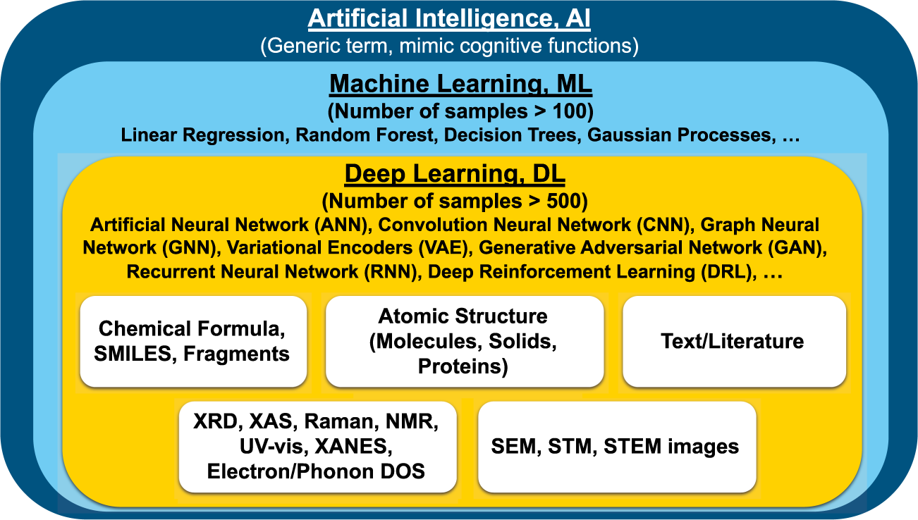
What is Machine Learning
Machine learning is a branch of artificial intelligence (AI) and computer science which focuses on the use of data and algorithms to imitate the way that humans learn, gradually improving its accuracy.
Machine learning is a crucial part of data science. It involves using algorithms and statistical methods to classify, predict, and discover insights in large datasets.
Choudhary, K., DeCost, B., Chen, C. et al. npj Comput Mater 8, 59 (2022)

Slide 3
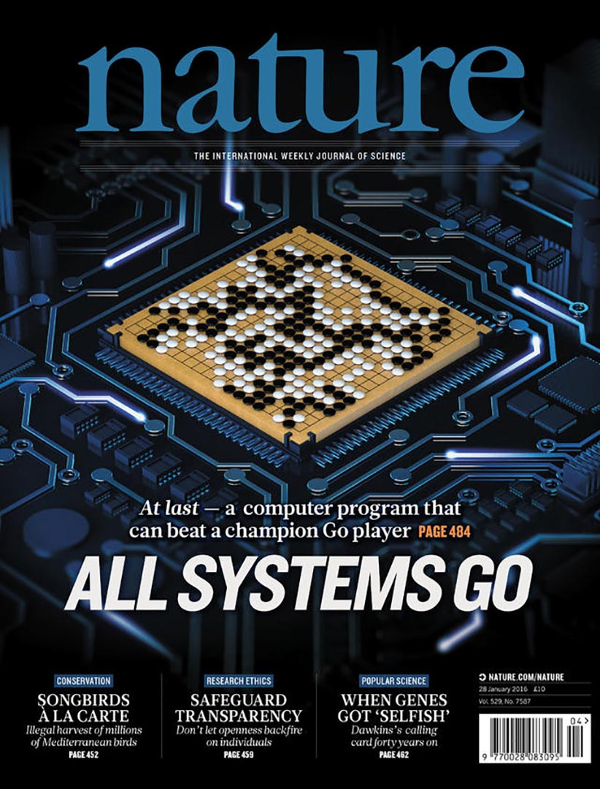
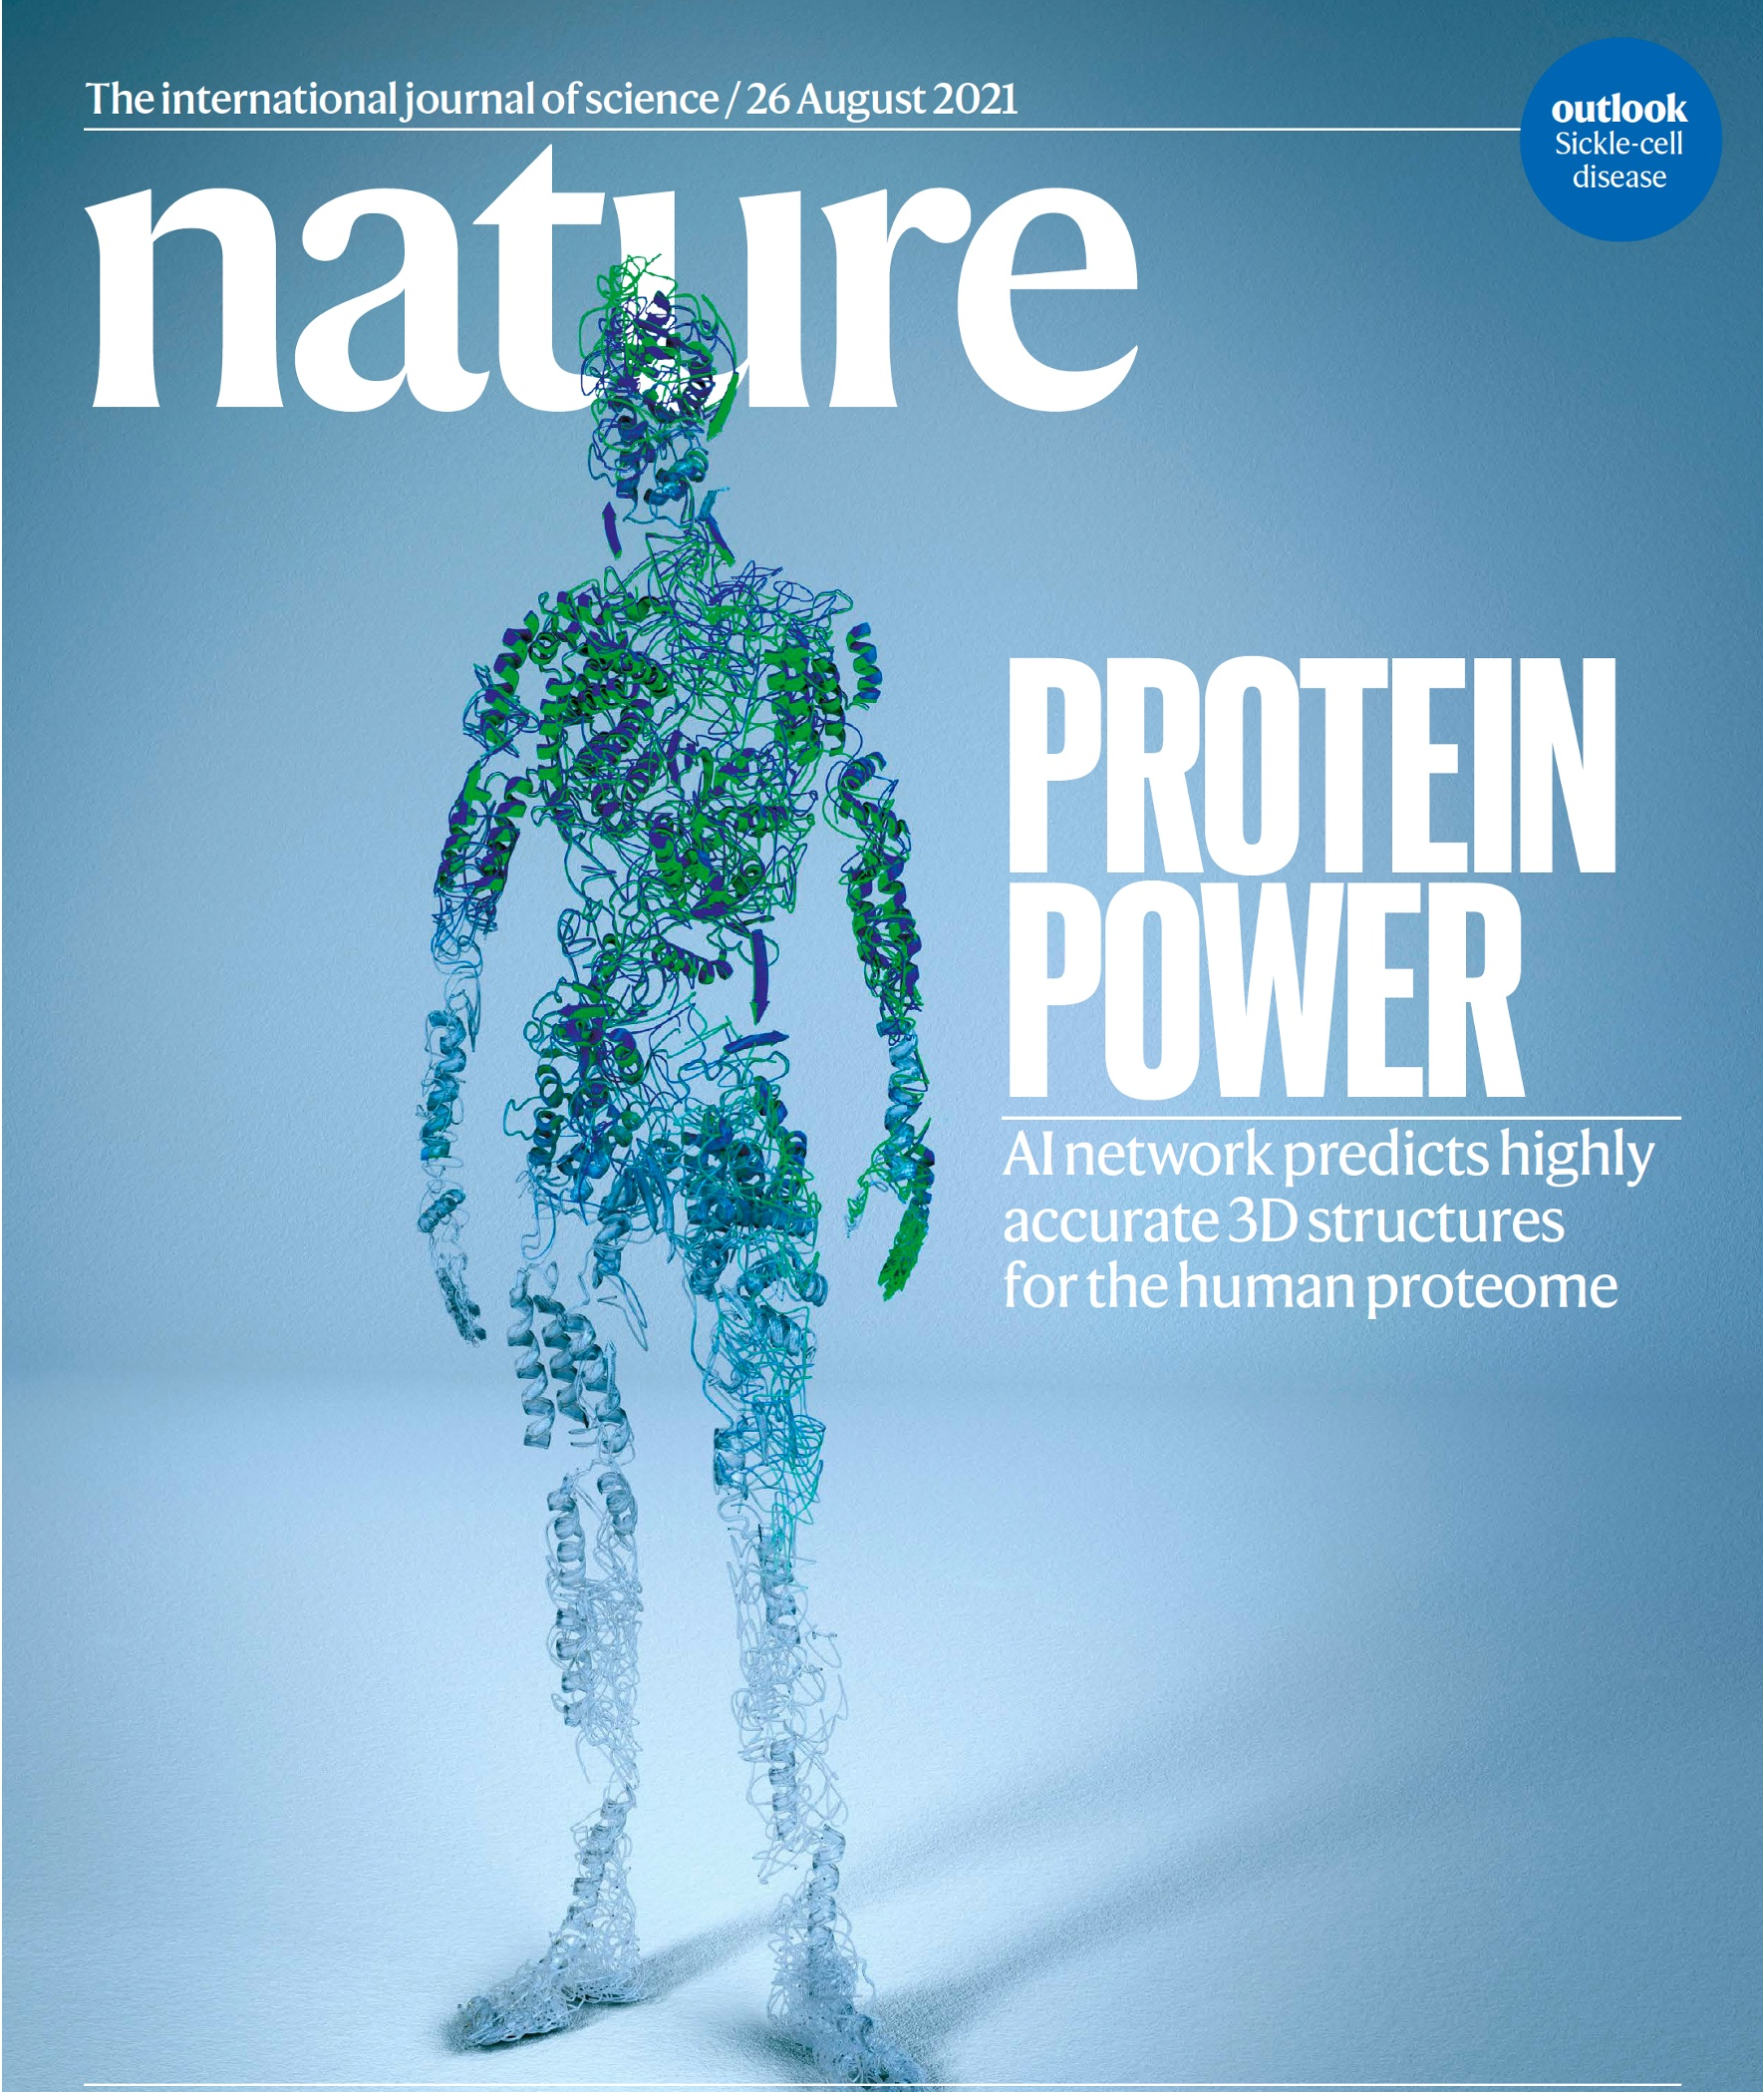
Applications of ML
Silver, D., Huang, A., Maddison, C. et al. Nature 529, 484–489 (2016)
Jumper, J., Evans, R., Pritzel, A. et al. Nature 596, 583–589 (2021)
Notes:
Two alpha that change the world
Alpha go prove that machine learning has it potential that can learning thing very fast , only 40 days, we can make a machine from zero to be a master of the game of go
One of the difficult chess in the world,
Furthermore , another application, Alpha fold2, published on nature ,which can successfully predict protein structure ,why we need to know structure? ,because the functionality of protein is determined by it’s structure

Slide 4
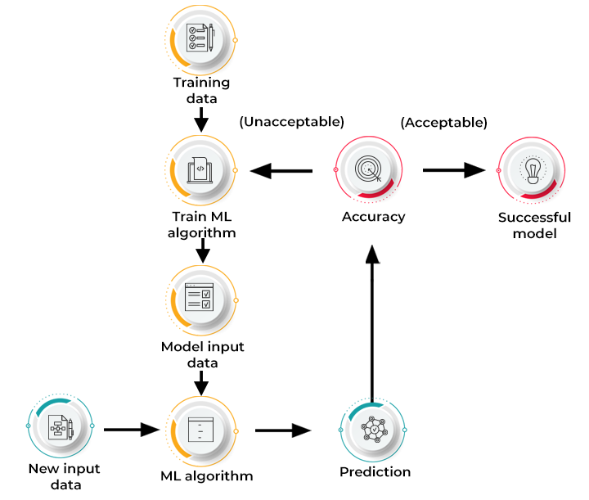
How does Machine Learning work?
https://www.spiceworks.com/tech/artificial-intelligence/articles/what-is-ml/

Slide 5
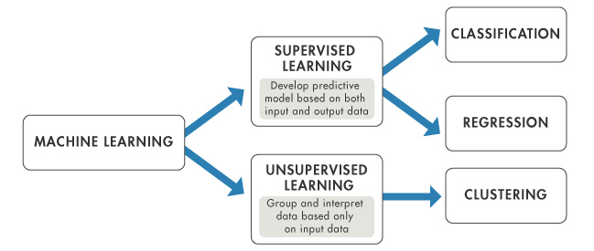
Type of Machine Learning Methods
Supervised Learning: Model learns from labeled training data to make predictions or classifications on unseen data. The goal is for the model to learn patterns and relationships in the training data, enabling it to generalize and make accurate predictions on new, unseen data.
Unsupervised learning: Model learns from unlabeled data without any predefined output labels. The goal of unsupervised learning is to discover patterns, structures, or relationships within the data.
Notes:
Overview of artificial intelligence (AI)

Slide 6

Classification vs. Regression
Classification: A process of finding a function which helps in dividing the dataset into classes In Classification, The task of the classification algorithm is to find the mapping function to map the input(x) to the discrete output(y).
Regression: A process of finding the correlations between dependent and independent variables. It helps in predicting the continuous variables.The task of the Regression algorithm is to find the mapping function to map the input variable(x) to the continuous output variable(y).

Slide 7





Deep Learning Framework

Slide 8
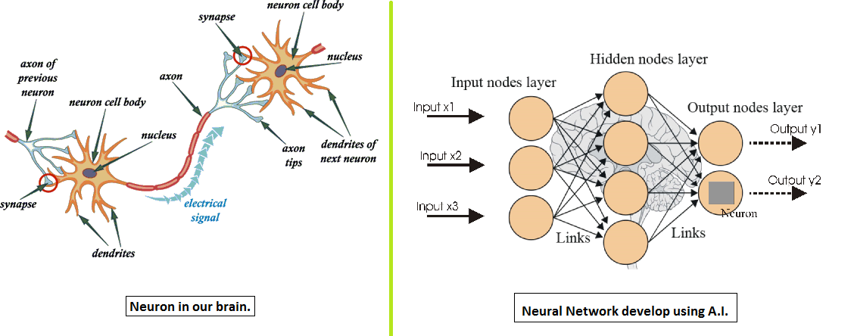
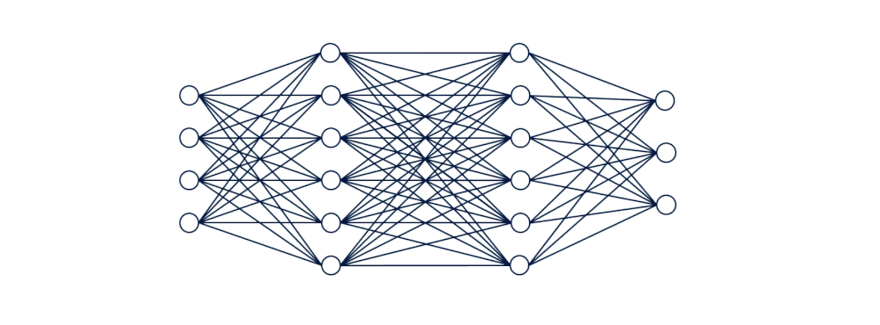
Artificial Neural Network (ANN)

Slide 9
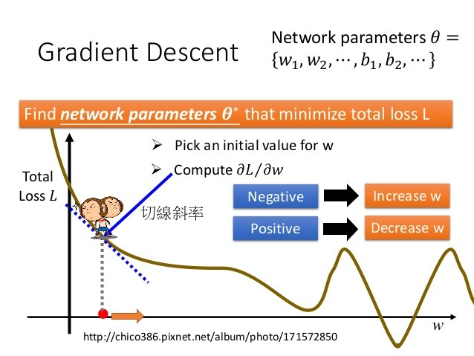

Gradient descent
Gradient descent is an optimization algorithm used in machine learning to minimize the loss or error of a model. It iteratively adjusts the model's parameters by taking steps proportional to the negative gradient of the loss function. It aims to find the optimal values that minimize the error and improve model performance.
slope

Slide 10
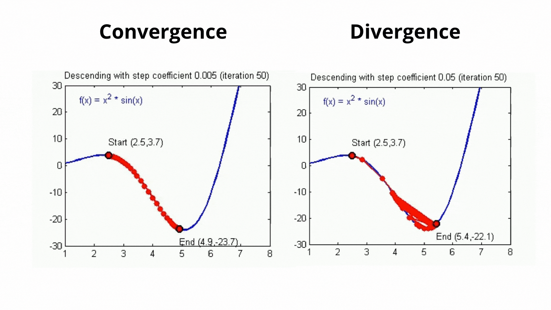
Learning Rate
Learning rate controls how much the parameters are adjusted based on the gradients of the loss function.
https://towardsai.net/

Slide 11
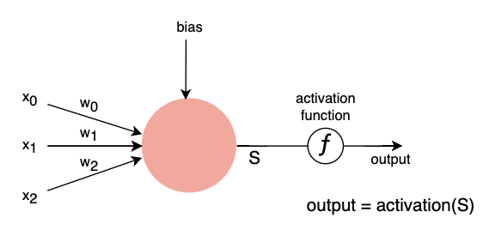
Activation Function
Activation functions are important in machine learning because they introduce nonlinearity, allowing models to learn complex patterns and make non-linear predictions. They also help propagate gradients during training and control the output range of the model for better interpretation and performance.

Slide 12

Activation Functions

Slide 13
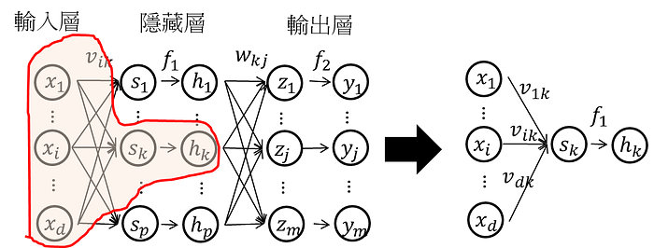
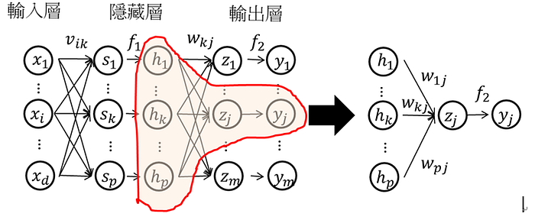
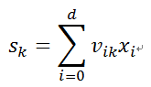
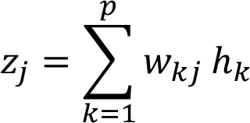
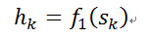
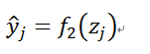
Forward Propagation
Through activation function
Output =

Slide 14
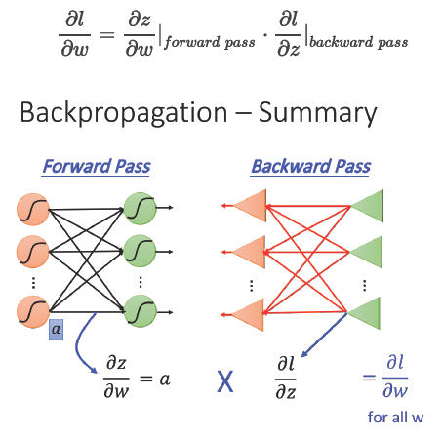
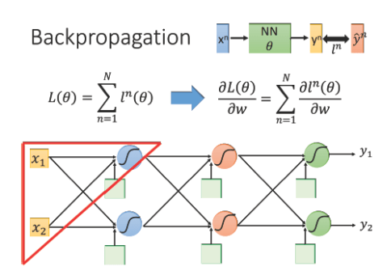
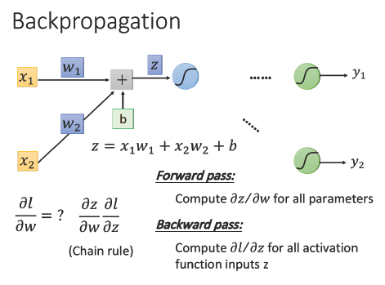
Backward Propagation
Notes:
loss function: L(θ) 等於所有的training data的loss總和
Forward pass 每一個neuron 的activation function 的output，就是他所連結的weight 的 ∂z/∂w
Backward pass 建一個與原來方向相反的neural network，它的三角形neuron的output 就是 ∂l/∂z，把通過forward pass 得到的 ∂z/∂w 和通過backward pass 得到的 ∂l/∂z 乘起來就可以得到 l 對 w 的偏微分 ∂l/∂w

Slide 15
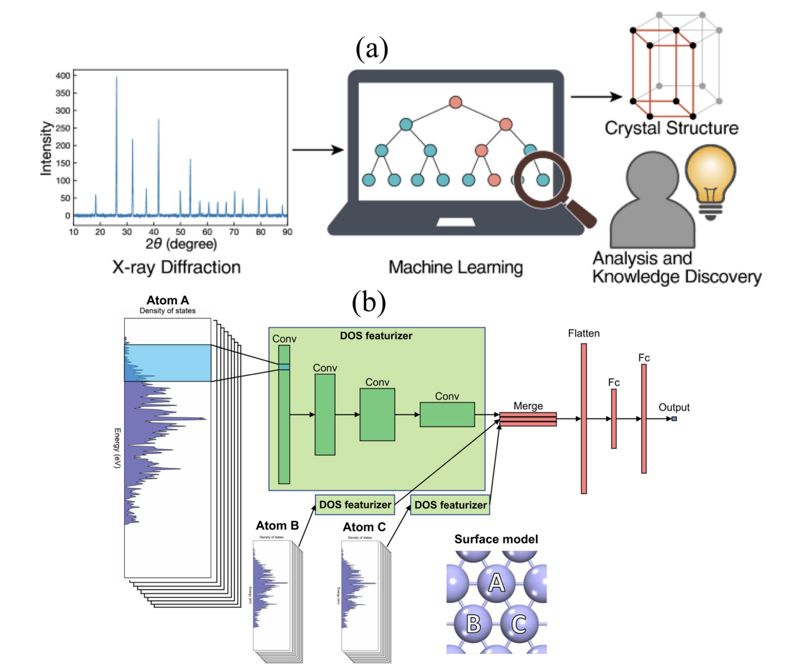
ML in Chemistry
Predict from X-ray::Suzuki, Y. et al. Sci. Rep. 10, 21790 (2020)
Predict from electronic density of states: Fung, V., Hu, G., Ganesh, P. & Sumpter, B. G.Nat. Commun. 12, 88 (2021)
Notes:
Choudhary, K., DeCost, B., Chen, C. et al. npj Comput Mater 8, 59 (2022).

Slide 16

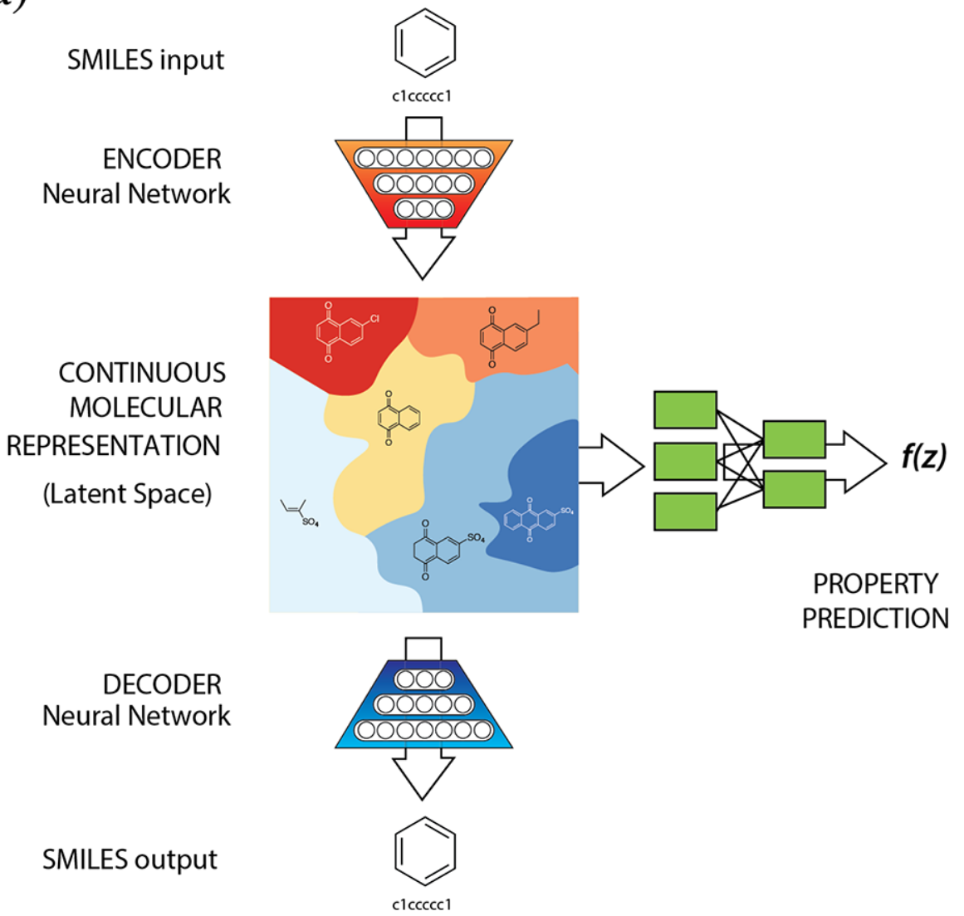
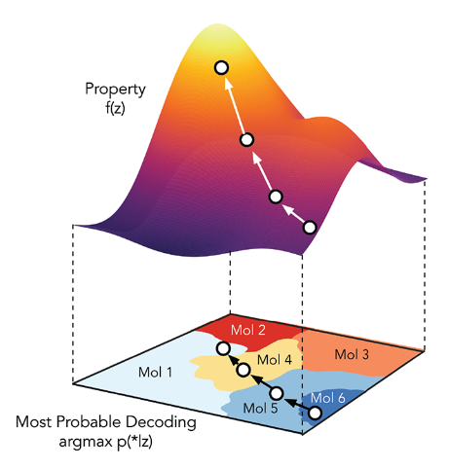
ML in Chemistry
VAE in chemistry: Gomez-Bombarelli, R.; Aspuru-Guzik, A.; and coworkers. ACS Cent. Sci. 2018, 4, 268
Notes:
VAE里面z到x的depencence是随机的，而GAN里是确定性的。这使得VAE的inference相对来说是well-defined的而GAN的inferernce相对来说是病态的。
这个建模上的区别也是来自于两者建模目的的不同。GAN就是为了生成新图片，而VAE除此之外，更想做的事情是建模数据的分布以及学到数据的隐含表示

Slide 17
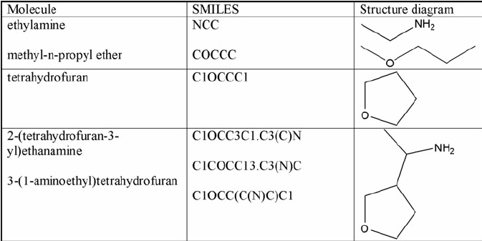
What is SMILES?
SMILES (Simplified Molecular Input Line Entry System) A chemical notation that allows a user to represent a chemical structure in a way that can be used by the computer.

Slide 18
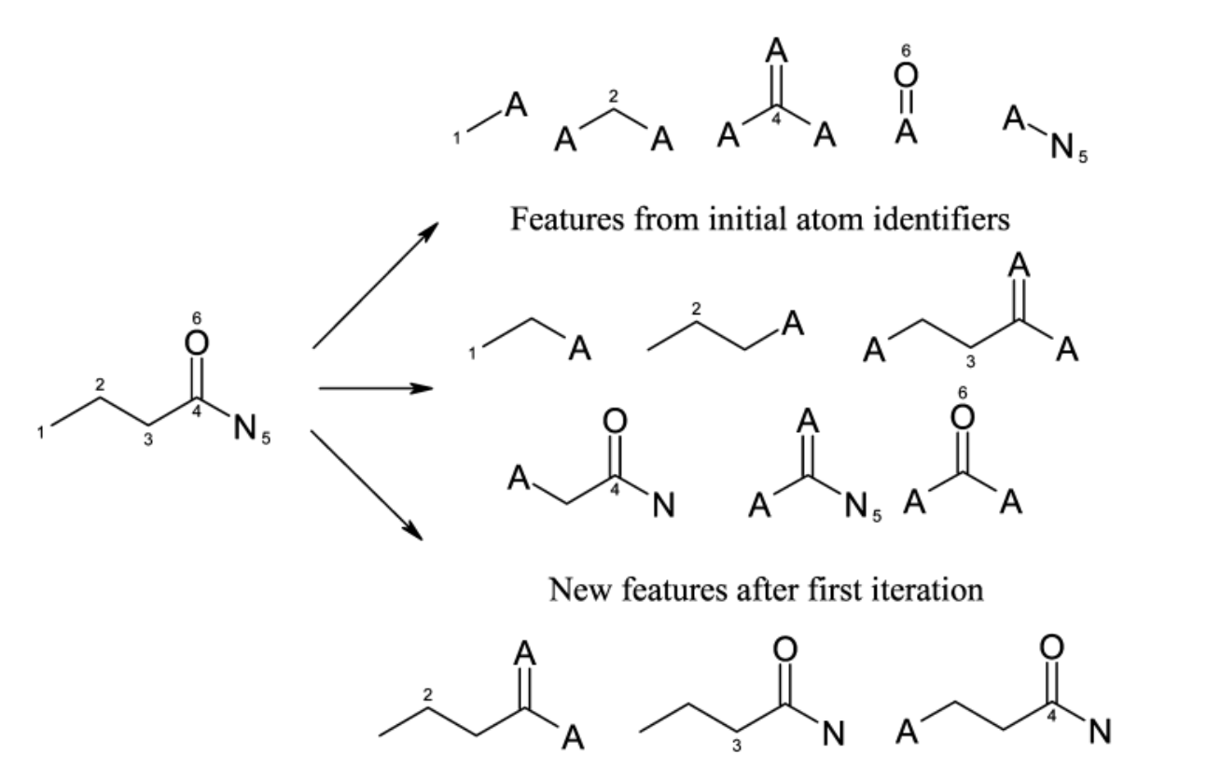
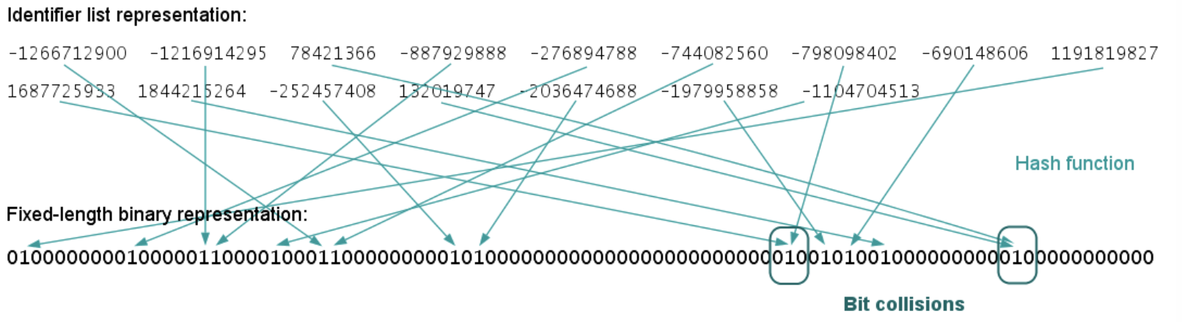
Molecular Fingerprint
Molecule fingerprints are binary bit strings that represent the structural features of a molecule. Uses a circular neighborhood around each atom in a molecule to capture local structural information.

Slide 19
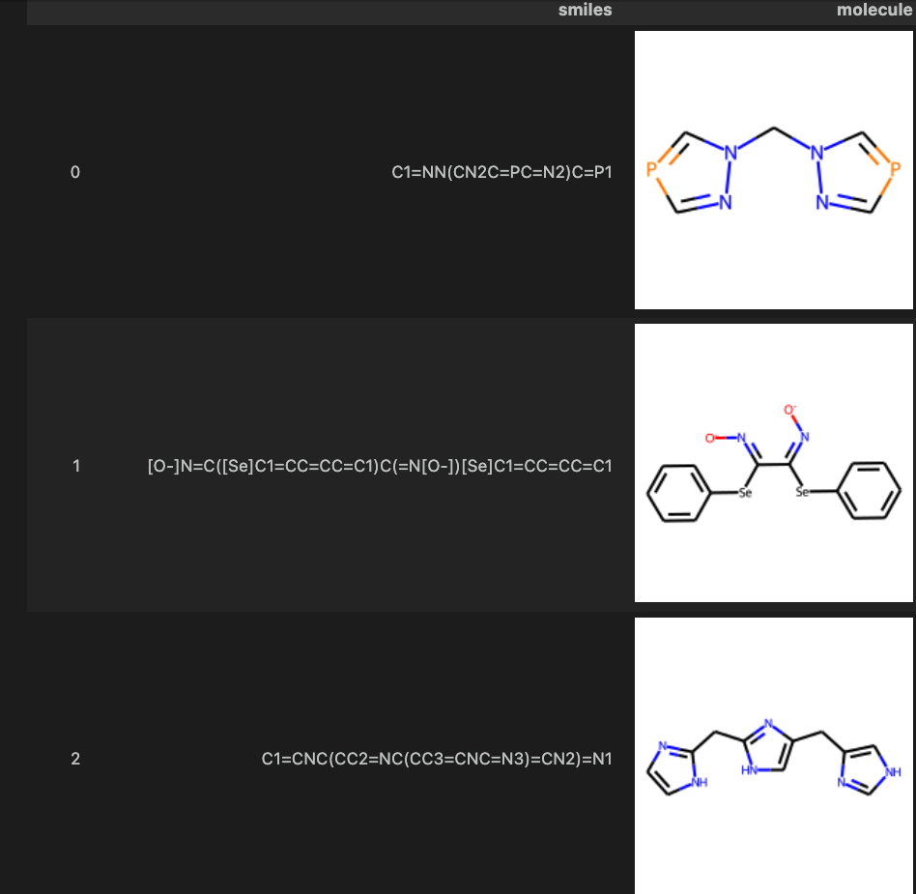
Interactive
Login to ${USER}@ln01.twnia2.twcc.aii
Go to exercise1
Click smi.ipynb
Run kernel
We can used python package easily show smile string to molecules

Slide 20
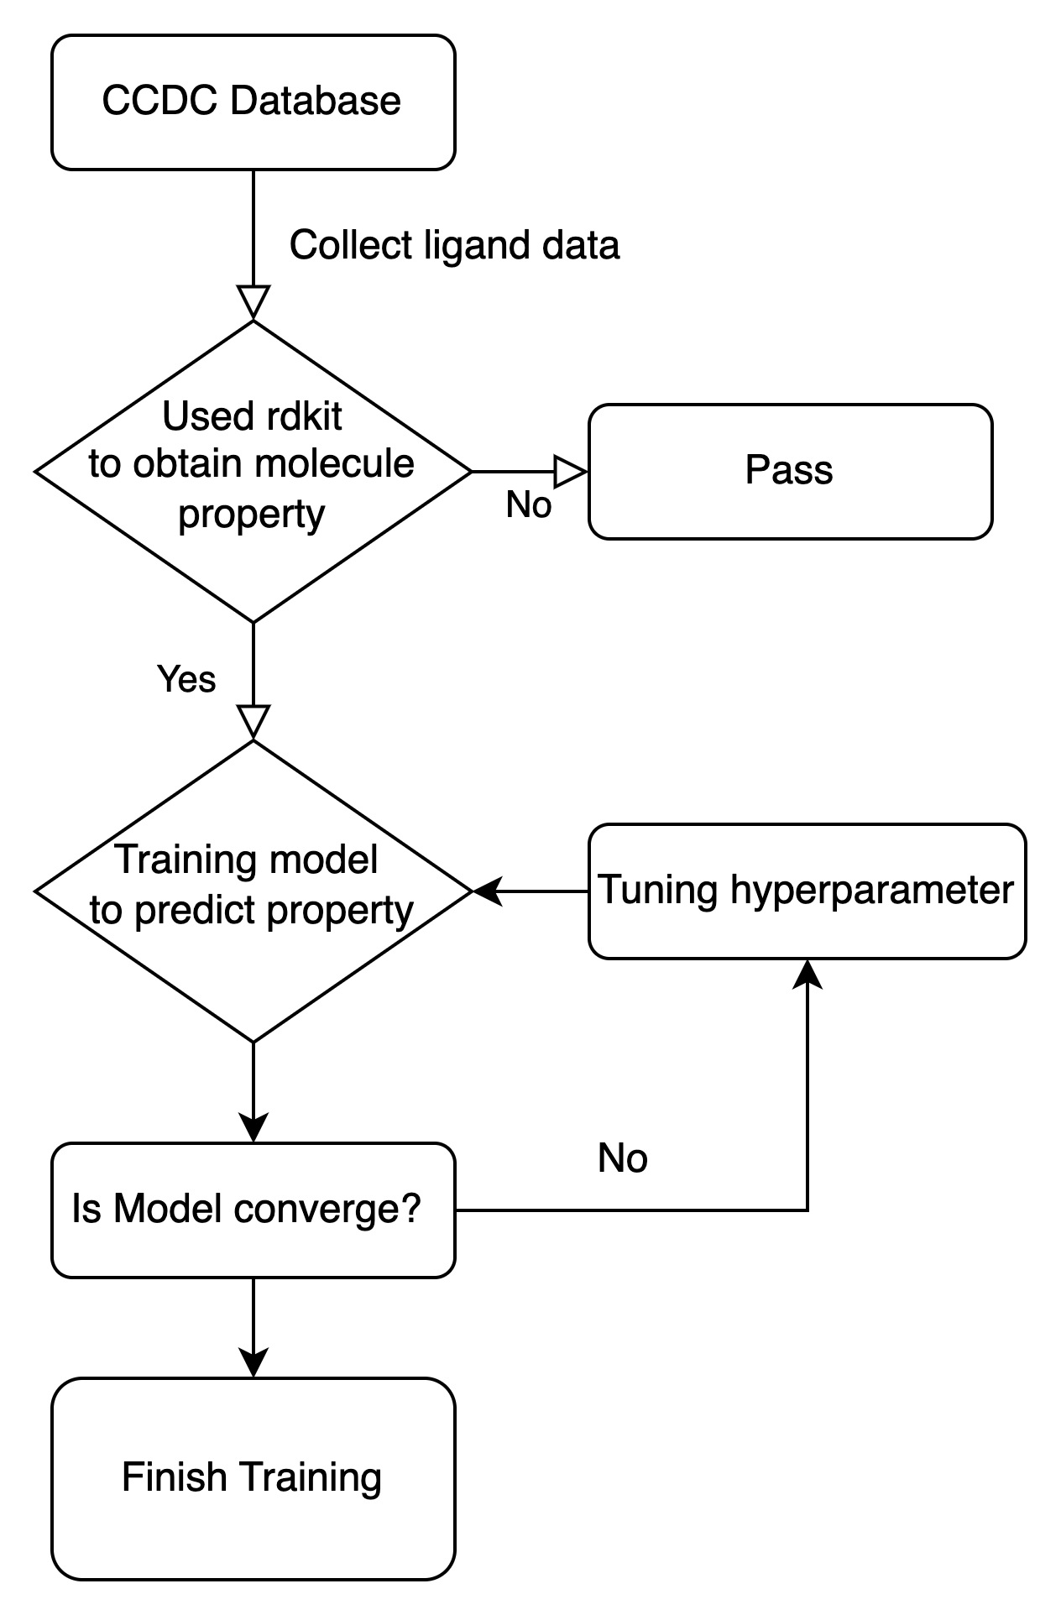
Interactive
1.Click smi_inform_retriver.ipynb
2.Run kernel
3.Used smi_infrom_retrivert to obtain logP, TPSA
Work Flow

Slide 21
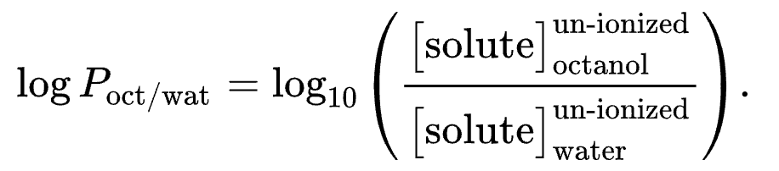
What is logp and TPSA
1.LogP (Partition Coefficient): LogP stands for logarithm of the partition coefficient. It is a measure of the lipophilicity or hydrophobicity of a molecule. LogP indicates how a molecule partitions between a nonpolar solvent (usually octanol) and water.
2.TPSA (Topological Polar Surface Area): TPSA represents the total polar surface area of a molecule. It is a measure of the surface area of a molecule that is involved in polar interactions, such as hydrogen bonding and dipole-dipole interactions. TPSA is calculated by summing up the contributions of individual polar atoms and functional groups in the molecule.

Slide 22
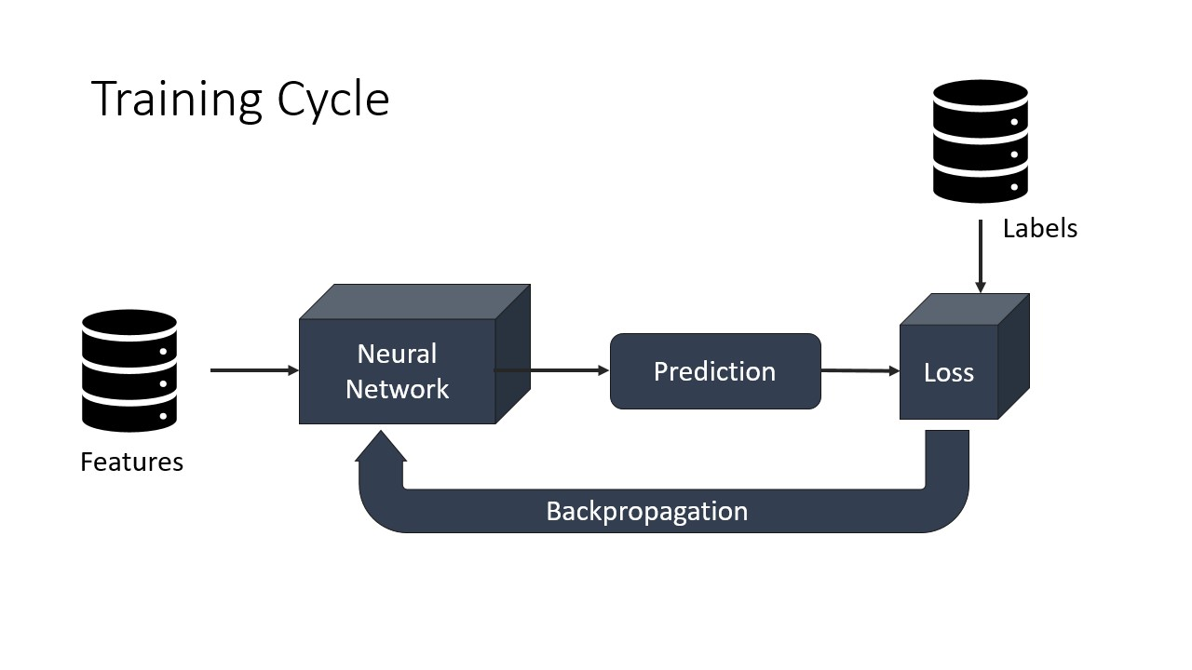
Interactive
1.Go to Exercise 2
2.Sbatch submit_training.sh
3.Training a model to predict molecules property

Slide 23
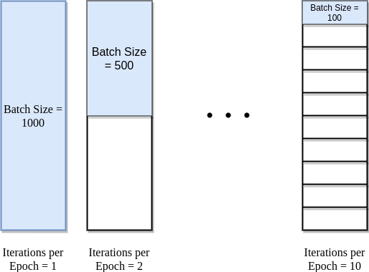
Details about training model
Dataset size = Iteration * Batch size （1 Epoch）Iteration = （Data set size / Batch size）* Epoch

Slide 24
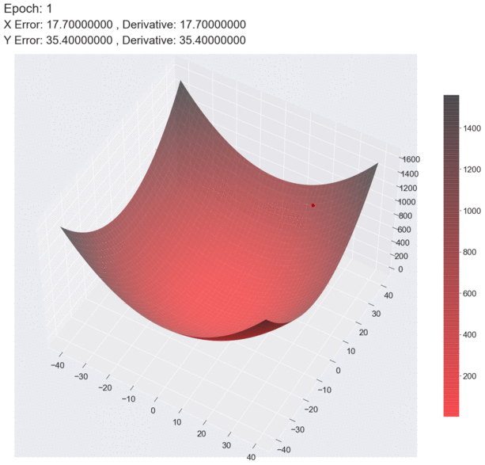

How batch size effect gradient descent
Batch size = 10
Batch size = 1
https://medium.com

Slide 25
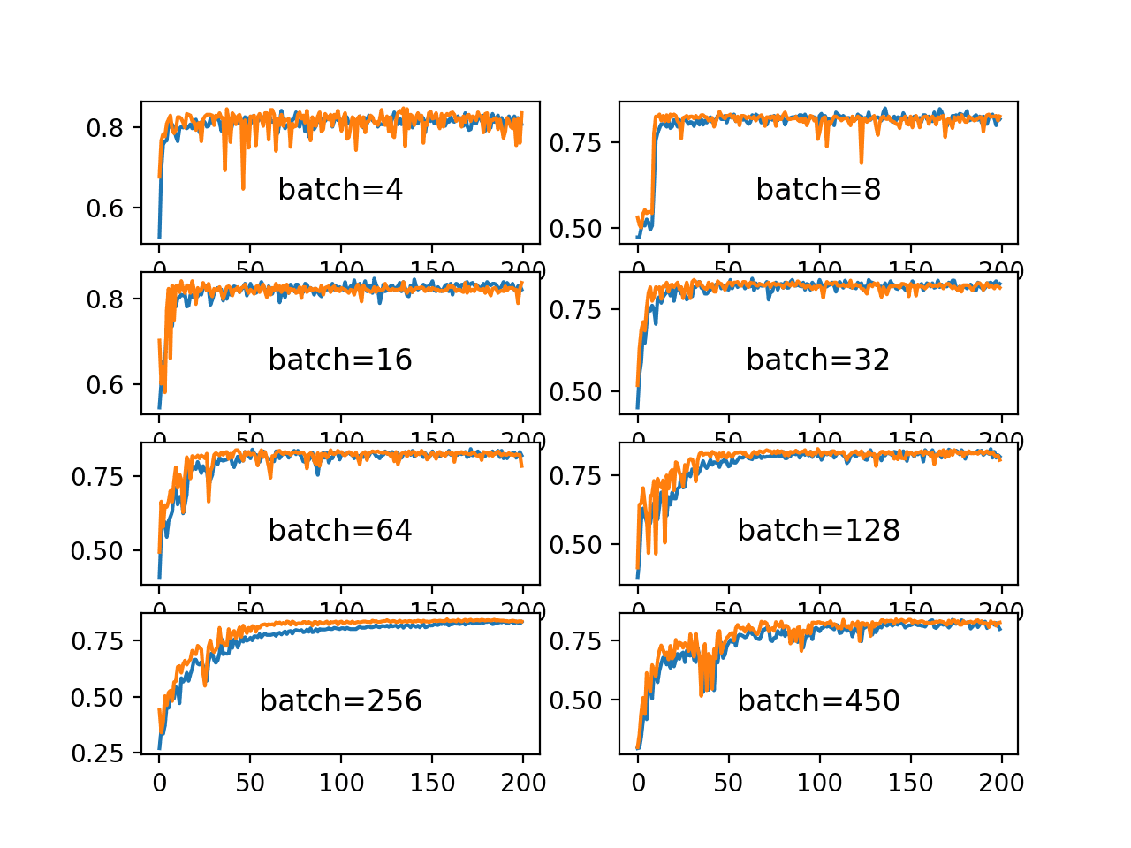
Is larger batch size always perform well?
Large batch size Advantages : provide smoother and more stable gradients, which can facilitate convergence. Large batch size
Disadvantages: Reduce the randomness in each iteration during training, which can affect the model's generalization ability.

Slide 26
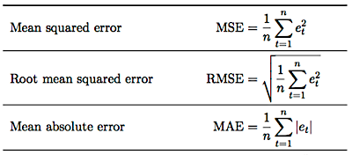
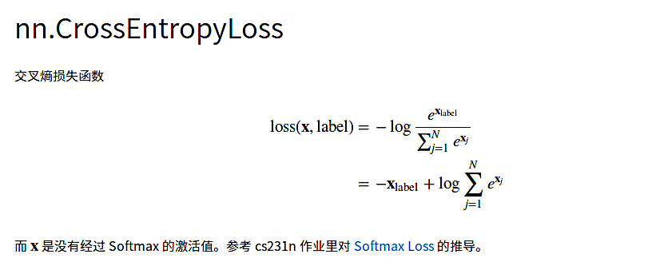
Loss Function
For regression case
For classification case

Slide 27
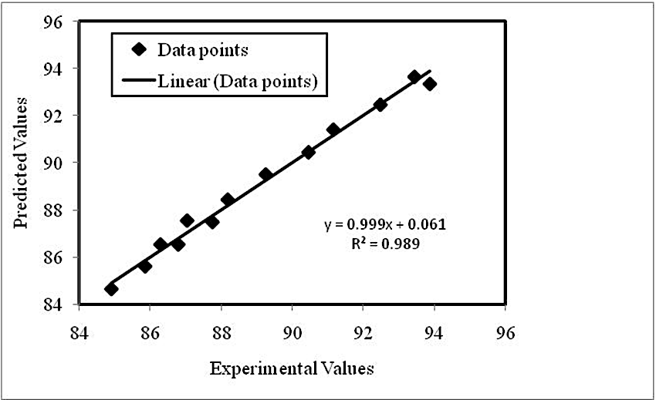

Parity plot
A parity plot is a scatterplot that compares a set of results from a training model against ground truth data. Each point has coordinates (x, y), where x is a true value and y is the corresponding value from the model.

Slide 28
Interactive
Go to Exercise 3
Click parity_plot.ipynb
Run kernel
Shown the parity of model prediction with ground truth
Analyzed the rmse loss and mae loss of model performance

Slide 29
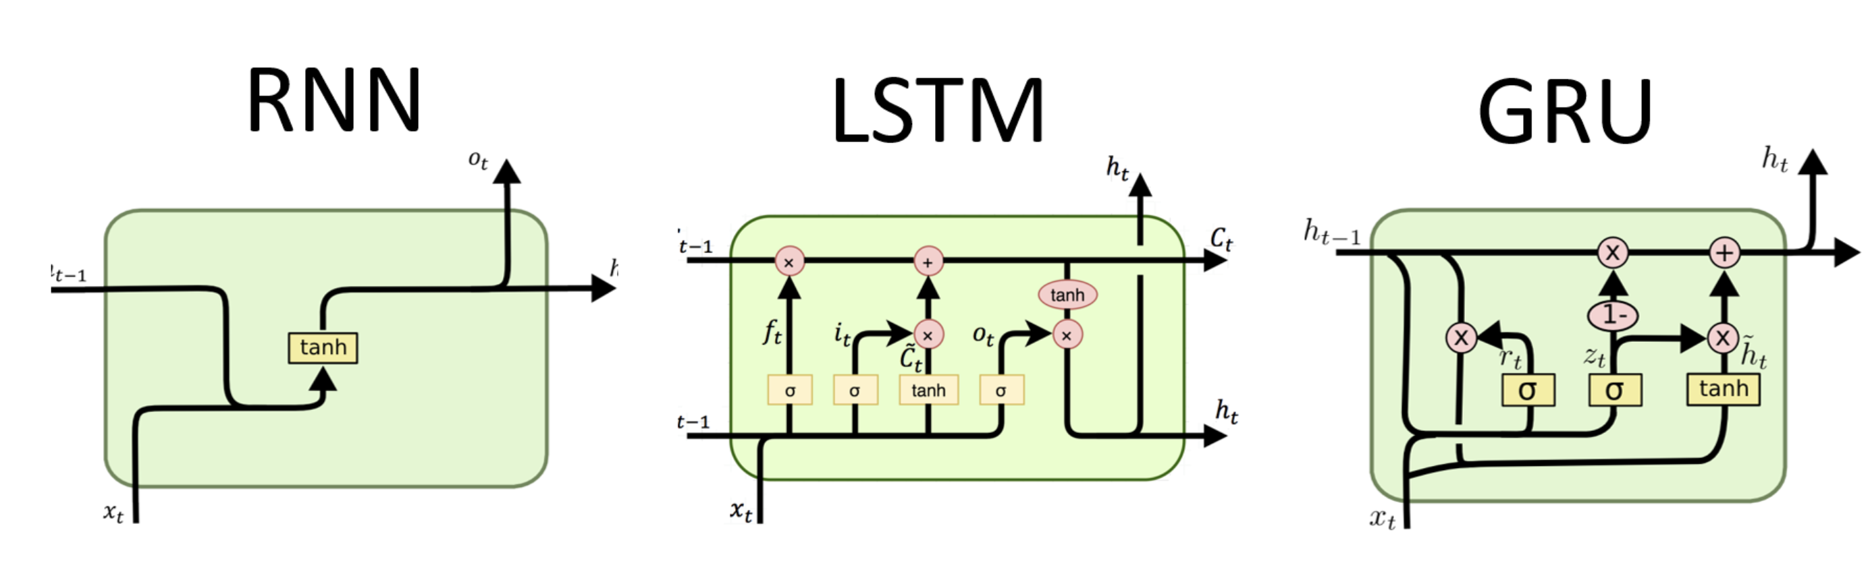
Recurrent Neural Network (RNN)
RNN : Mostly used in language model, speech recognition, RNNs have feedback connections, which allow them to maintain an internal memory of past computations, making them capable of handling sequences of arbitrary length

Slide 30

Convolutional Neural Network(CNN)
CNN : Used in image classification, object detection. It utilizes convolutional layers, which apply filters to input data to extract relevant features. By using shared weights and pooling operations, CNNs can capture spatial hierarchies and learn patterns at different scales

Slide 31
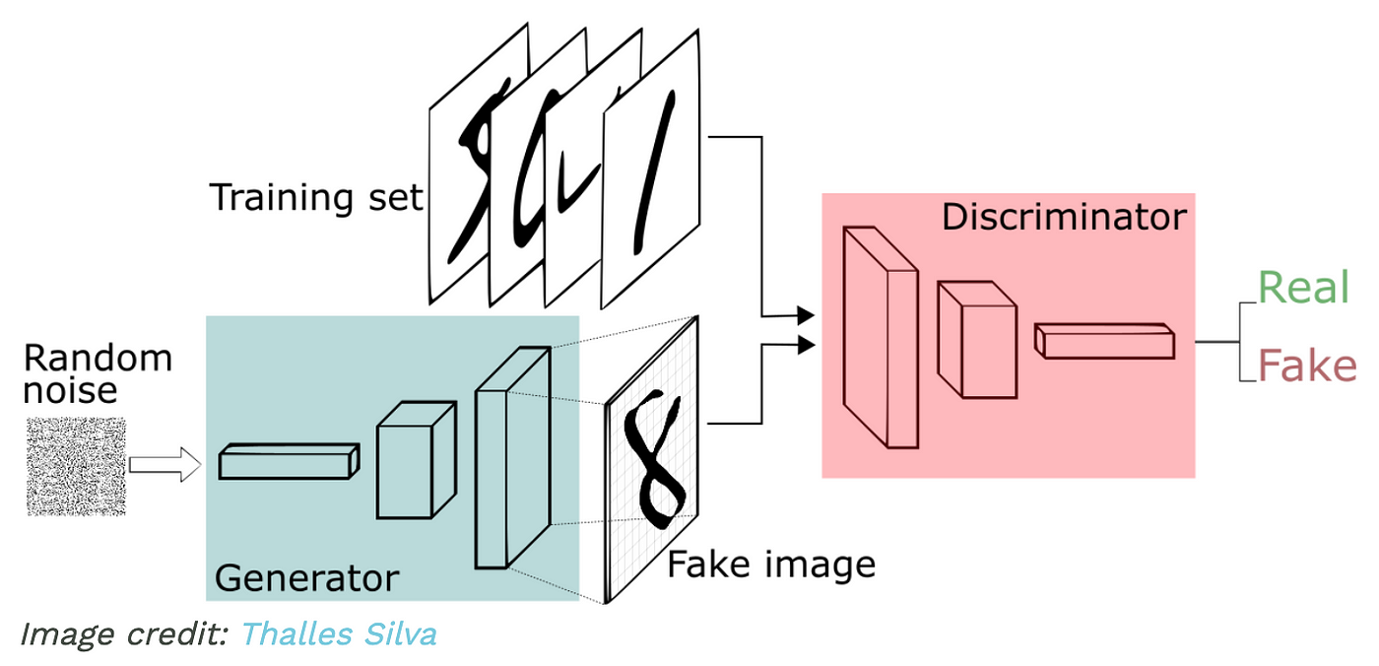
Generative Adversarial Network (GAN)
GAN : The core idea of a GAN is based on the "indirect" training through the discriminator, another neural network that can tell how "realistic" the input seems, which itself is also being updated dynamically. GANs are used for generating synthetic data that resembles a specific input dataset

Slide 32
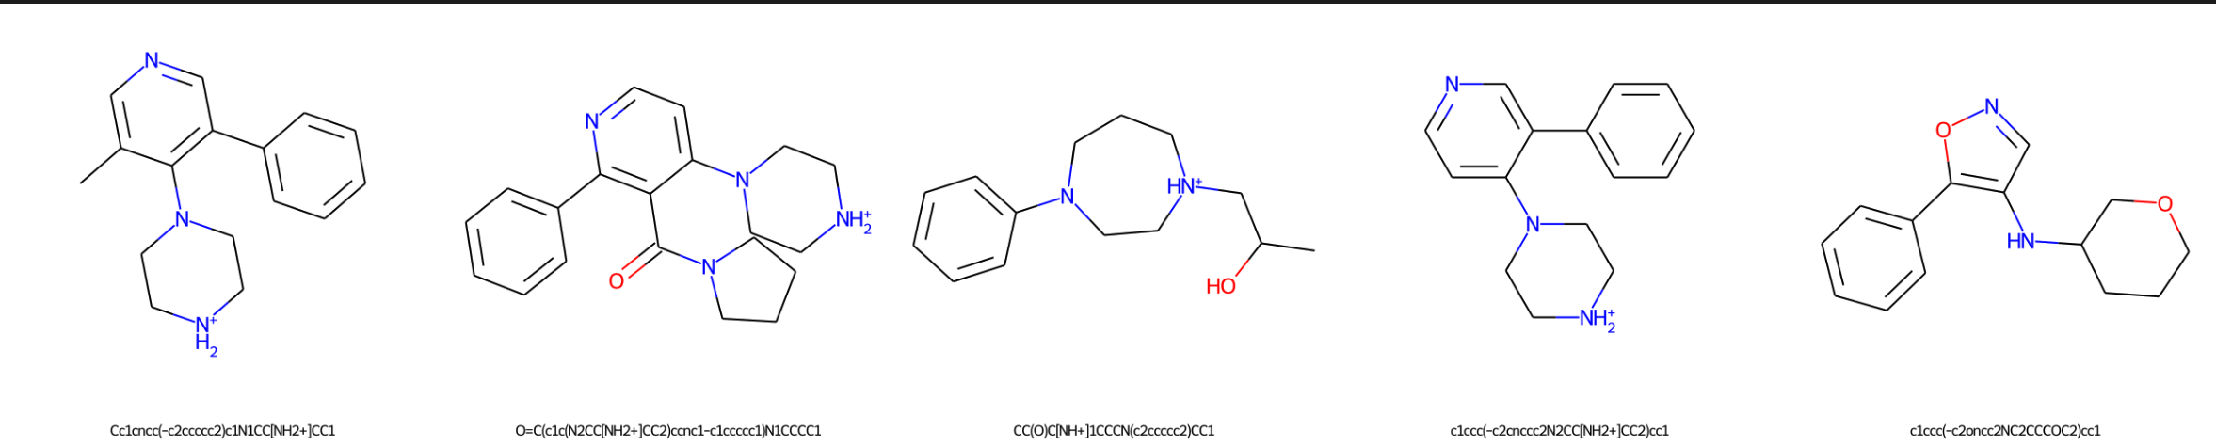
Interactive
Go to Exercise 4
Click Generatesample.ipynb
Run kernel
Assign a smiles string that model can generate similar molecule
Run kernel
Model generate nearby molecule

